Slide 1

Disaster
Resilience
October 28, 2019

Slide 2
WELCOME
Ray Young
City Manager, City of Troutdale
219 E. Historic Columbia River Hwy., Troutdale, OR 97060
W: 503.674.7233
C: 503-702-1949
Alice Busch, EMT, CEM, ORCEMS
Division Chief, Operations
Multnomah County Office of Emergency Management, MCEM
Alice.Busch@Multco.us
W: 503-988-6552
C: 971-563-3051

Slide 3
What questions do you hope to have answered tonight?

Slide 4
OBJECTIVES
Awareness of Hazards and Situation
Conversations
Understanding of Plan(s)
Preparedness
Community Connections/Social Capital,
Training/Practice, and Water & Medications

Slide 5
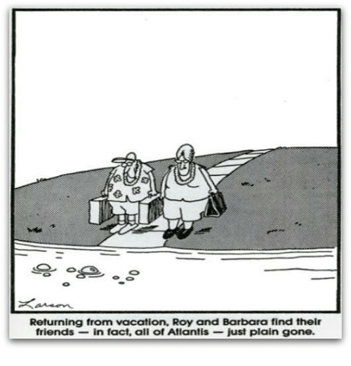

Slide 6
Emergencies & Disasters
Home Fires and Wildfires
Severe Weather – snow/ice
Volcano
Technological
Terrorism/Acts of Violence
Land movement – mudslides, landslides
Contagions
Tsunami – OR and WA residents and visitors
9 Cascadia Subduction Zone Earthquake
https://multco.us/file/65292/download
Notes:
Ray will cover the first three
The Tsunami is NOT coming up the river
If you are on the coast - 100 vertical feet up
https://www.oregongeology.org/pubs/tim/p-TIM-overview.htm
Do your own Hazard Vulnerability Assessment – what hazards are around your home? Your work? Your social activities? Your children’s school? Faith communities?

Slide 7
Role of County Emergency Management
Planning: THIRA, Hazard
Mitigation, Response, Recovery
SA/COP Situational Awareness
& Common Operating Picture
Damage Assessment and
Restoration of:
critical infrastructure, supply
chains, lifelines
Scarce Resource
Allocation/Prioritization and
Coordination: fuel, water
Points of Dispensing – meds
Points of Distribution – stuff
Emergency Medical Services, Transport & Surge
Search and Rescue
Reunification
Debris Removal
Emotional Support
Continuity of Government
Volunteer Management
Donations Management
Evacuation Support
Sheltering and Mass Care
(Long Term Housing)
Information Provision
Recovery
Notes:
Counties need to be able to prepare for, respond to and recover from disasters in a timely fashion, and as part of this preparation, they need to ensure that critical infrastructure, such as energy, water, communications and transportation, remain operational, or that service can be quickly returned to normal following a disaster
By having a better understanding of the interconnectedness of lifelines, and how damages to one sector can cascade and affect others, county leaders will be better prepared to address vulnerabilities in their county and protect their lifelines
Lifelines have a set of defining characteristics that separate them from other sectors and services provided In general, there are four main factors that define lifelines:
They provide necessary services and goods that support nearly every home, business and county agency,
Lifelines deliver services that are commonplace in everyday life, but disruption of the service has the potential to
develop life-threatening situations,
They involve complex physical and electronic networks that are interconnected within and across multiple sectors, and
A disruption of one lifeline has the potential to effect or disrupt other lifelines in a cascading effect 4
Eachcountyhasdistinctivecharacteristics,betheygeographyandterrain,demographicsoreconomicdrivers As such,theneedsofasmallruralcountyaregoingtobedifferentthanthoseofalargerurbancounty Countieswill invariably define lifelines differently from one another, but there are four main lifeline categories that apply to virtu- ally every county across the nation:
Energy, such as oil, natural gas and electricity,
Water, including potable water and wastewater systems,
Transportation, including roads, bridges, rail, airports and ports, and
Communications, including telephone, satellite and Internet infrastructure 5

Slide 8
Hazard Perception
Firefighter deaths (17) – 3,450 people
What kills us?
  Heart disease 610,000
  Flu 23,000 – 48,000
  Falls 30,000 – 35,000
  Motor vehicle crashes 32,000 – 42,000
  Natural Disasters – 477 – 10,000
  Panic - Looting
Notes:
Falls include bicycle falls
On average – very few people die from natural disasters in the United States each year.
Which means – regardless of the severity of the disaster, odds are – you will likely survive. This means preparing is essential – as you will most likely be around to either be thankful for your efforts, or will be suffering the consequences
Informed Choice vs. Panic
Myth: The most common reaction of people caught up in disasters is to panic. Information about
hazards and disasters should not be widely disseminated because people will panic.
Reality: Research generally shows that victims rarely panic; rather people’s actions are more likely to be guided by choice and efforts to help those around them who require it, particularly where informed choices are available before or during the event. Auf der Heide (1989) elaborates:
‘Contrary to popular belief, research has shown that panic is not a common reaction to disasters (Dynes, 1974:71; Dynes, 1981:16,18; Quarantelli, 1960:68; Quarantelli, 1965:107; Quarantelli, 1972:67; Mileti, 1975:57; Drabek, 1986:136; Wenger, 1975:33; Wenger, 1985a:30). This is not to say that panic never occurs, but that it is rare. Furthermore, if it does occur, three conditions appear to be required (Mileti 1975:58):
a perception of immediate danger,
apparently blocked escape routes, and
a feeling by the victim that he is isolated.
Finally, if panic occurs, it is not widespread or contagious. It is most always highly localized, with few participants, and of short duration (Quarantelli1960:72).’ Auf der Heide gives various historical
Literature and best practice review and assessment: identifying people’s needs in humanitarian response
20
examples to evidence this lack of panic which is also borne out by testimony of those involved in more recent disasters.
Auf der Heide concludes his analysis with a reminder of key principles for planners, asking whether those responsible for issuing warnings to the public understand that widespread panic is not a common problem in disasters, but that convincing people to evacuate is. The more information about what to do in an emergency is available, the more likely it is that people will feel empowered to act in an informed, responsive and responsible manner. This has been such a consistent theme in the research literature that the recommendations below of Dynes, Quarantelli and Kreps (1972:31), foremost researchers in this field, remains as relevant today as ever:-
‘Information about dangers should be disseminated and not withheld because of a fear that people will panic’ (Dynes, Quarantelli and Kreps 1972:31).
Human Behavior
Myth of panic and infrequency of ‘looting’
Increase in behavior
Benevolence / Malevolence
Fight or flight syndrome effects
Research has demonstrated that when looting does occur it is relatively isolated and infrequent.
http://www.slate.com/articles/health_and_science/science/2012/11/looting_after_hurricane_sandy_disaster_myths_and_disaster_utopias_explained.html
http://www.atsdr.cdc.gov/emergency_response/common_misconceptions.pdf
Refusal to evacuate – fear of looting http://onlinelibrary.wiley.com/doi/10.1111/j.1559-1816.1999.tb00132.x/abstract
The 1906 San Francisco earthquake killed 3,000 people and destroyed 80 percent of the city. Even as the Los Angeles Timesreported that “Rape and looting by friends incarnate made a hell broth of the center of the ruined district,” the U.S. War Department recounted, “the terrible days of earthquake and fire in San Francisco were almost absolutely free from disorder, drunkenness and crime.”
Exaggerated media reports of looting can undermine outsiders’ empathy and willingness to assist. In an attempt to understand how outsiders respond to reported crime, researchers from Stanford and UCLA presented study participants with different examples of Hurricane Katrina coverage, and then asked them to award federal funds to the affected community. Study participants responded significantly less generously to disaster reports that emphasized crime and looting rather than focusing on just hurricane destruction.
False reports of looting may even have triggered an overly militant response in post-Katrina New Orleans amid one of the worst — and least representative — examples of post-disaster antisocial behavior. According to ProPublica’s 2010 report on post-Katrina NOLA police, in the days after the storm Mayor Ray Nagin said on television that “there had been rapes and murders among the people taking shelter in the Superdome, a claim that turned out to be untrue. Police Superintendent Eddie Compass made similar statements.”
With broken communication systems, officers could not confirm or deny the television reports. In the face of chaos, if not legitimate danger, an order — origins still unknown — authorized officers to shoot looters and “take back the city.” Ultimately, in the dark days following Katrina, police shot 11 civilians, some of whom were in the course of removing food, water and other basic necessities from stores.
Under the strain of floods and fires, American cities act cooperatively, not criminally. Accurate warnings, fair reporting and an emphasis on the shared experience of a disaster and the many positive efforts to cope with it allows powerful community norms to prevail over fear, prejudice and crime.

Slide 9
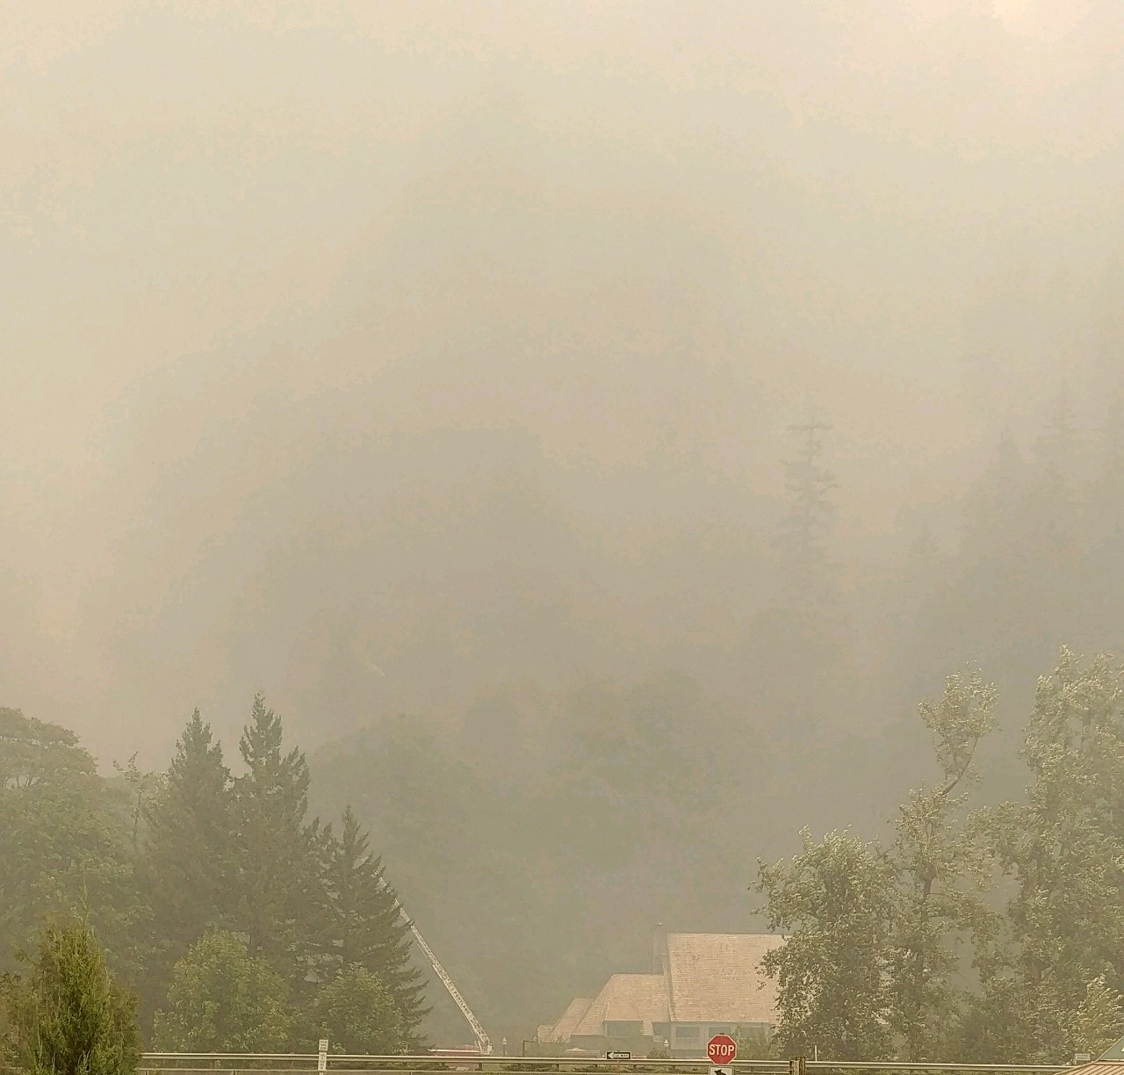
Air Quality
https://oraqi.deq.state.or.us/home/map

Slide 10
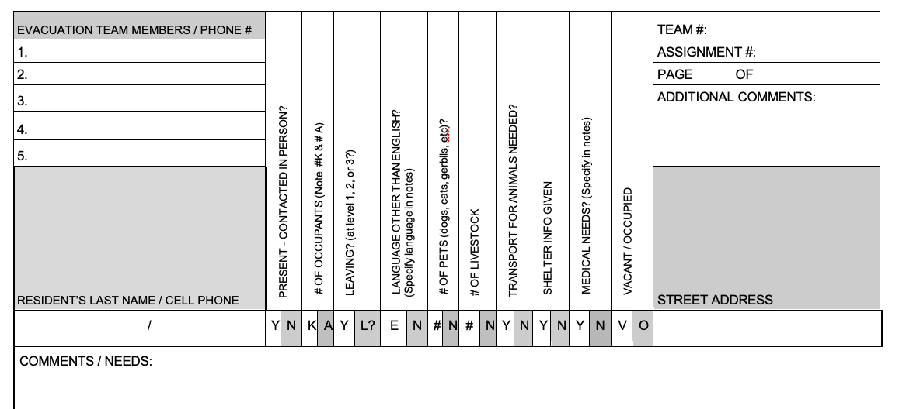
Evacuation

Slide 11
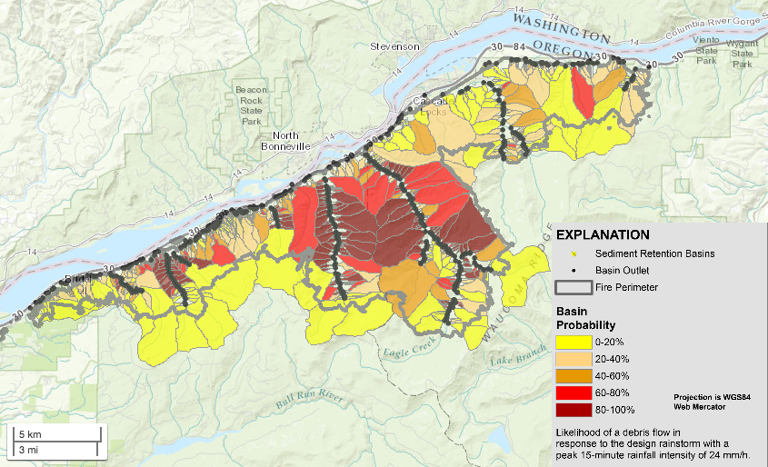
Land Movement Response Planning
Debris Origin
Notes:
Significant risks - NWS messaging - current procedures
Will need to work with Records for getting messages out to operational staff

Slide 12
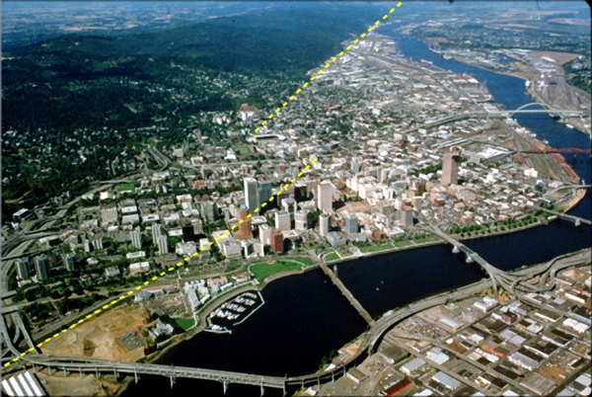
Portland Hills Fault
Notes:
12
Portland Hills fault is considered an ‘IF’ earthquake by geologists. Cascadia is considered a “WHEN’ earthquake.
The impacts from this earthquake across the Portland Metro area – would be more significant than the Cascadia EQ.

Slide 13
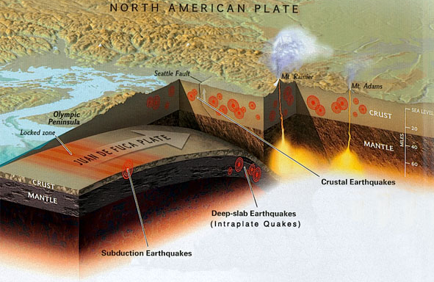
Subduction Zone EQ
Notes:
Other types of earthquakes and their durations (crustal, intra-plate - 15-45 seconds)
Anyone been in an EQ?
Length of fault line - 600-800 miles
How they determine where fault lines are.
http://www.hawaii247.com/2011/09/08/volcano-watch-can-earthquakes-trigger-volcanic-eruptions/
Volcano Watch: Can earthquakes trigger volcanic eruptions?
Posted on September 8, 2011. Tags: earthquakes, hvo, usgs, volcano watch, volcanoes
(Volcano Watch is a weekly article written by scientists at the U.S. Geological Survey’s Hawaiian Volcano Observatory.)
Seismologists are often asked the question, “Can large earthquakes trigger volcanic eruptions?” The short answer is yes, earthquakes and volcanic processes are closely linked, as suggested by the existence of the “ring of fire” of active volcanoes and earthquakes circling the Pacific Ocean.
A volcanic eruption occurs when the force of the magma plumbing system exceeds the force holding the rock together between the magma chamber and the surface. For earthquakes that are relatively close to an active volcano, the displacement of the earthquake itself can change the stresses around the magma chamber, possibly bringing the volcano closer to an eruption. Depending on the type of earthquake and the geometry of the fault, different areas around the earthquake source area may be subject to increased compression or relaxation. A nearby magma chamber that experiences relaxation of the crust above the chamber as a result of a large nearby earthquake would be more likely to erupt because less force would be required from within to push the crust apart.
In principle, large, distant earthquakes, like the magnitude-9 (M9) quake in Japan in March 2011, send seismic waves across the globe. Much like shaking up a soda pop can, passing seismic waves can induce bubble formation, density and/or viscosity changes, increasing the pressure within the magma chamber and possibly increasing the likelihood of an eruption of a distant volcano. Since the actual forces imparted on the magma chamber from distant earthquake waves are generally low with respect to the force imparted by the magma chamber itself, the magma chamber must already be poised for an eruption.
Globally, we see ample evidence for both types of triggering. In regions that have experienced a M9 earthquake or larger in the last 75 years (Kamchatka, Chile, Alaska, Indonesia), several nearby volcanoes in areas of relaxation from the earthquake erupted in the weeks to months after the earthquake. Mount Merapi, Indonesia, showed significant changes in activity following two local earthquakes (M6.3 in 2001, M6.3 in 2006). After the M7.9 Denali earthquake in Alaska, no volcanic eruptions were triggered, but earthquake swarms occurred at several distant volcanoes (Mount Rainier, Washington; Long Valley Caldera, California; and Yellowstone Caldera, Wyoming), suggesting a change in the respective magma systems in response to the passing seismic waves.
In Hawai`i, interplay between earthquakes and volcanic activity has been observed, but the details of the cause-and-effect are complex. M4-5 earthquakes are common under the south flank of Kilauea after intrusions within the Upper East Rift Zone. The 1868 M6.1, M7.0, and M7.9 earthquakes were likely triggered by the eruption of Mauna Loa that was occurring at the time. In contrast, the 1975 and 1984 eruptions of Mauna Loa were both preceded by moderate earthquakes (>M5) months in advance; however, it is unclear whether these events induced a magmatic intrusion or were triggered by an existing magmatic intrusion. The 1975 M7.2 Kalapana earthquake, which occurred on a fault patch under the entire Kilauea Summit and East Rift Zone area, was followed within hours by a short eruption at the summit of Kilauea. In addition, many of the patterns in activity within the magmatic system of Kilauea irreversibly changed after the earthquake, suggesting significant changes within the magmatic system.
Seismic waves from large, distant earthquakes (such as the Japanese earthquake) have produced few obvious changes in the magmatic systems of Kilauea or Mauna Loa. One exception was the cessation of a deep intrusion under Mauna Loa in 2004 after the passage of seismic waves from the 2004 M9.3 Sumatra earthquake.
When looking at whether eruptions are triggered by earthquakes, it seems clear that both large local earthquakes and large distant earthquakes can bring a volcano closer to eruption. If a volcano is already poised to erupt, the changing stress patterns may result in an eruption. More commonly, large earthquakes simply goose the magma plumbing system, producing earthquake swarms or changing the behavior of the magma plumbing system, but not triggering an eruption. Our understanding of the complex interaction between volcanism and seismicity will improve through the continued study of both seismology and deformation over a long period of time.

Slide 14
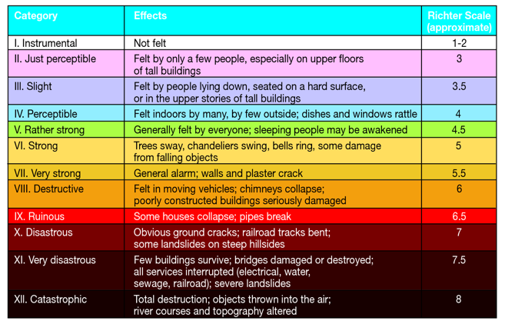
Observed/Felt Measured

Slide 15
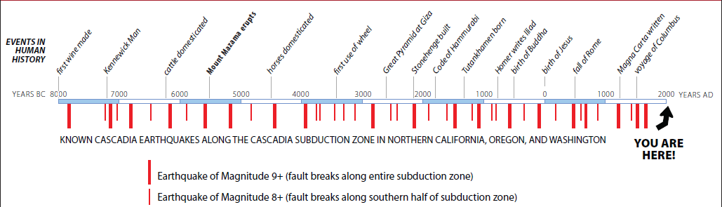
The average time between Cascadia events is 230 years. The last earthquake was 319 years ago.
Recurrence
Notes:
Check the “LAST EQ date – January 26, 1700
Definition of the average – as little as 40 and as long as 1,000, that being said, we have past 75% of the intervals above.
38% chance –
Goldfinger, C, Nelson, C H, , Morey, A, Johnson, JE, Gutierrez-Pastor, J, Eriksson, AT, Karabanov, E, Patton, J, Gracia, E, Enkin, R, Dallimore, A, Dunhill, G, Vallier, T, the Shipboard Scientific Parties (2009) Turbidite event history: methods and implications for Holocene paleoseismicity of the Cascadia Subduction Zone. US Geological Survey Professional Paper 1661-F, in press
Mw = MMS – Moment Magnitude Scale
15

Slide 16
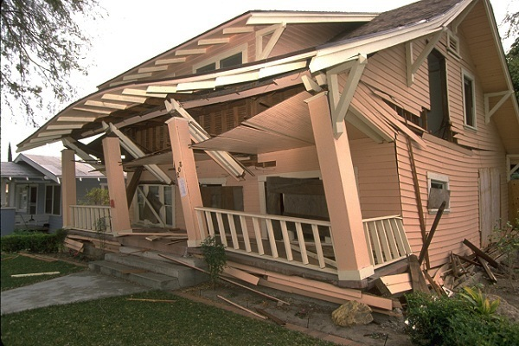

Slide 17

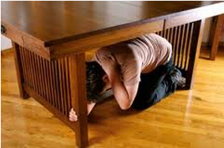
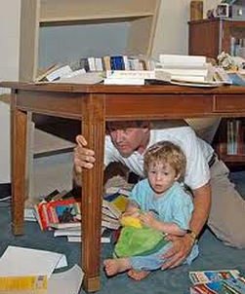
Notes:
Note that the most important thing to protect is the head
The child in foreground NOT correctly practicing Drop-Cover- and Hold on
Also – the child in the background is also NOT practicing correctly. He won’t have adequate leverage to get up/out if the desk comes down on him. More power in your legs so you can push up. People in the bottom slides are practicing perfect. They are in a better position to get up and out. On Knees, protecting head (and child) and holding on.

Slide 18
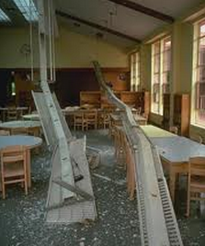
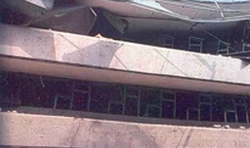
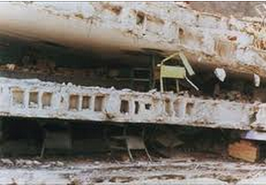
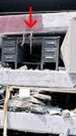
Notes:
Desks are not meant to hold up the floors of buildings.
The photo with the arrow is from the debunked ‘triangle of life’ guy – who states he was a firefighter and search and rescue responder. The image from his own website reinforces our safety messages regarding Drop-Cover-Hold On, and Beneath, Beside, Between. Find something sturdy to hide under or next to – let some of the energy of falling debris get absorbed by something OTHER than you – if at all possible.

Slide 19
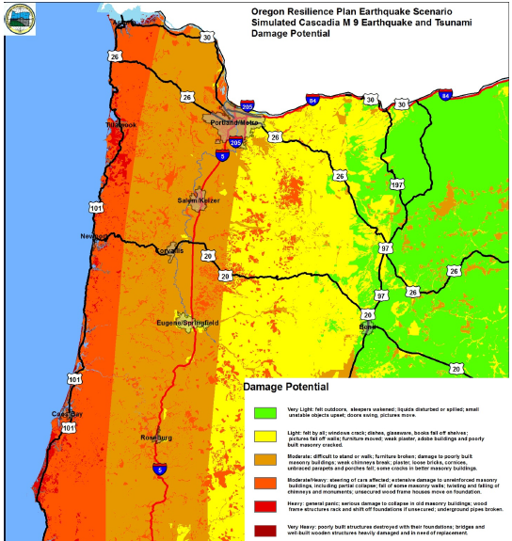
Notes:
From Oregon Resilience Plan
http://www.oregon.gov/oem/Documents/Oregon_Resilience_Plan_Final.pdf

Slide 20
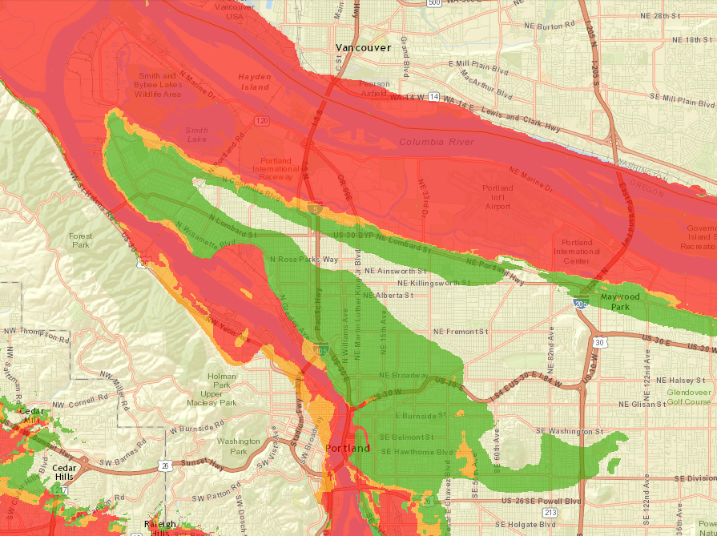
http://www.oregongeology.org/hazvu/
http://www.oregongeology.org/hazvu/
http://www.oregongeology.org/hazvu/
Notes:
http://www.oregongeology.org/hazvu/
https://fortress.wa.gov/dnr/protectiongis/geology/
http://bhs.idaho.gov/Pages/Plans/RiskMap.aspx
http://serve.mt.gov/ready-montana/montana-hazards/

Slide 21
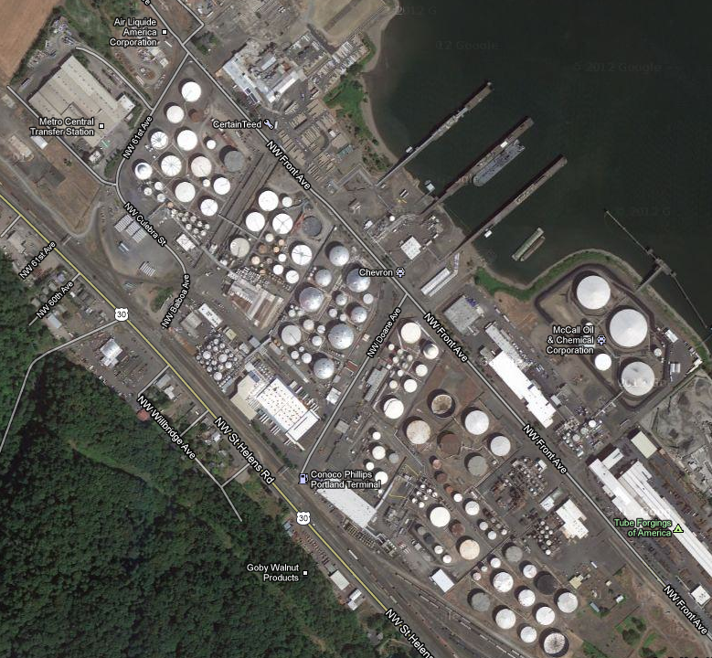
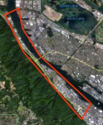
Notes:
See:
Earthquake risk study for Oregon's critical energy infrastructure hub - http://www.oregongeology.org/sub/earthquakes/cei-hub-report.pdf
Portland Local Energy Assurance Plan - https://www.portlandoregon.gov/pbem/article/389162
Mike Harryman testimony - Oregon Legislative Information System - https://olis.leg.state.or.us/liz/2017R1/Downloads/CommitteeMeetingDocument/107662
Electricity, Natural Gas, and Liquid Fuel Widespread power outages are expected throughout the Pacific Northwest, with partial blackouts in every city located within 100 miles of the coast in Washington and Oregon and in parts of northwestern California. Natural gas pipelines and compressor stations are also likely to sustain damage, leaving customers in western parts of Washington and Oregon without service. Restoration times for electricity and natural gas will depend on location—it may be a matter of days in some inland areas, but a matter of weeks or months nearer the coast. Many of the region’s refined fuel terminals and numerous pump stations along the pipeline system in Washington and Oregon are expected to suffer damage; and ground displacement may cause numerous breaks and leaks in both crude- and refined-product pipelines that run north-south in the western Long lines at gas stations were a familiar sight in New York and New Jersey after damage caused by Hurricane Sandy led to power outages, fuel shortages, and rationing.
FIRE: Damaging earthquakes often start fires, as was famously illustrated by the great San Francisco earthquake and fire in 1906 (left). Typical causes of fire are downed electrical lines and broken natural gas pipelines. Mitigation, such as fitting natural gas pipelines with automatic or remote shut-off valves and installing flexible connections, can substantially reduce the risk. The City of Vancouver in British Columbia has also prepared for this hazard by installing a dedicated fire protection system. Completed in 2003, this quake resistant system allows firefighters to pump water from False Creek and Coal Harbour. zones of these states. Because of damage to shipping channels, it may not be possible to transport petroleum by boat from the refineries in Puget Sound to Portland and other points along the Columbia and Snake rivers. Without the ability to store and distribute liquid fuels locally, shortages are likely, affecting not only the use of vehicles and aircraft, but also critical facilities and key industries. As with other structures, the vulnerability of the region’s energy infrastructure is variable. For example, Oregon’s critical energy infrastructure hub is in the Willamette River valley in an area where the ground consists of layers of river sediments and man-made fill. Until the older structures are retrofitted or rebuilt and the ground beneath them is treated, this hub is judged to be very vulnerable and may incur extensive damage during a Cascadia earthquake.

Slide 22
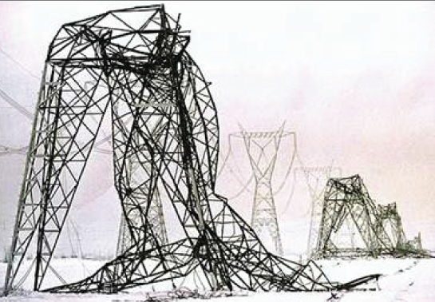
Infrastructure: Northridge Earthquake M6.7/20 sec

Slide 23
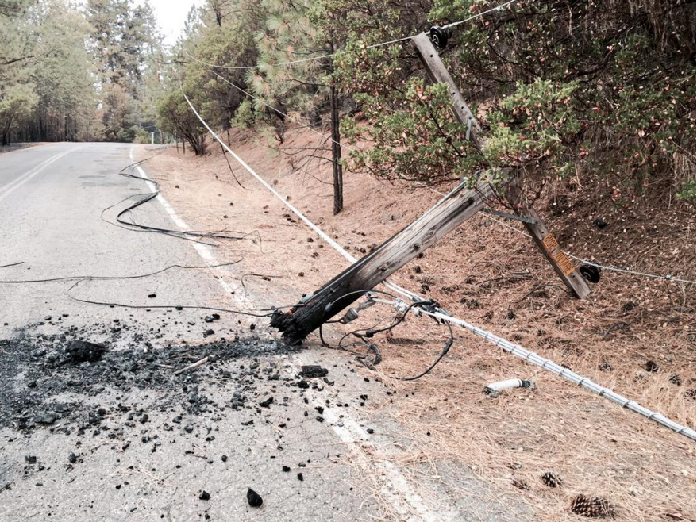
Wildfire

Slide 24
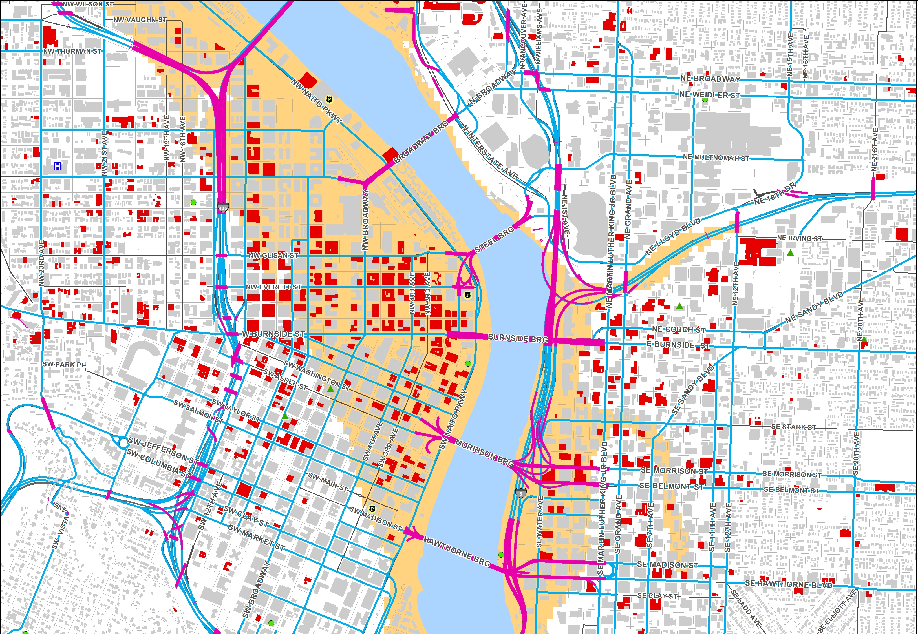
http://tinyurl.com/ztqnchw
Notes:
http://pdx.maps.arcgis.com/apps/Viewer/index.html?appid=a920f2a1fd2746f1a7efad1262aa1312
URM database link

Slide 25
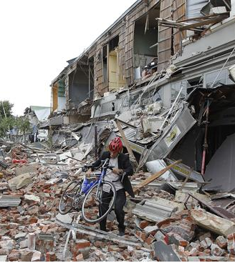
Christchurch
EQ M6.3
26 sec

Slide 26
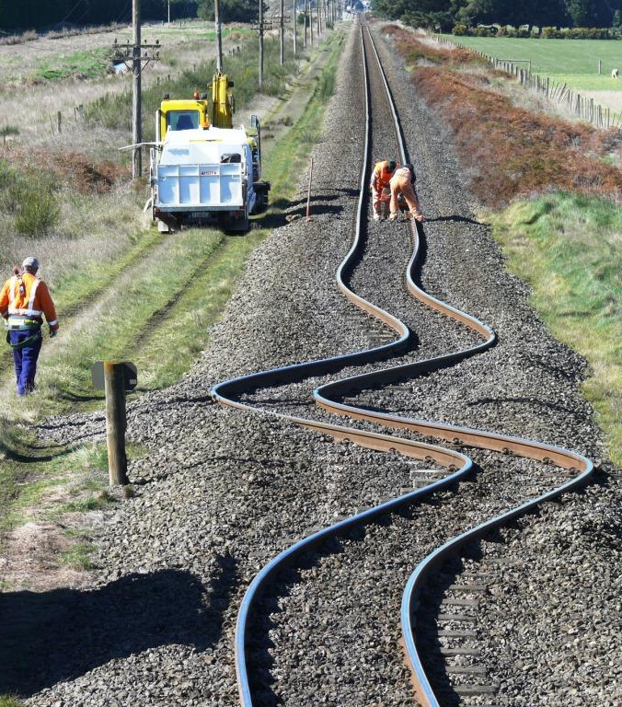
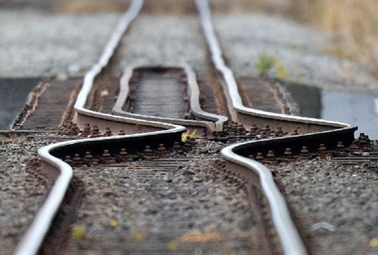
Christchurch
EQ M6.3/26 sec
Notes:
Christchurch 2011, 6.3 estimated duration of 26 seconds

Slide 27
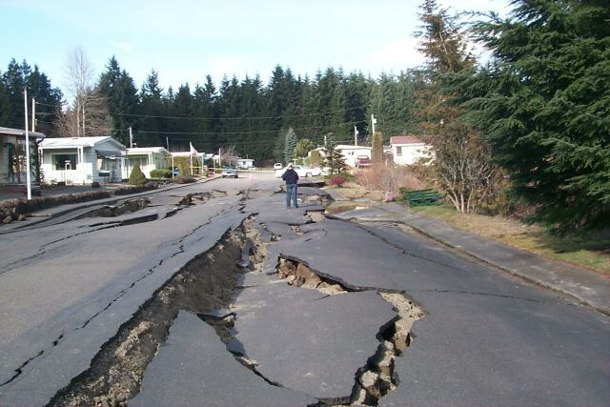
Nisqually EQ M6.8/46sec

Slide 28
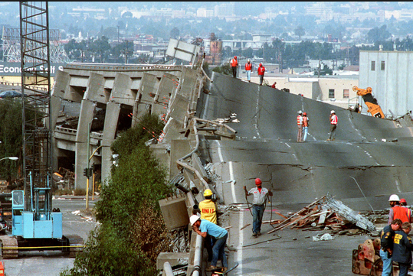
Loma Prieta EQ M6.9/15 sec
Notes:
This is Loma prieta 6.9 – 15 seconds
Our Cascadia Subduction Zone EQ is expected to last 3 – 5 MINUTES

Slide 29
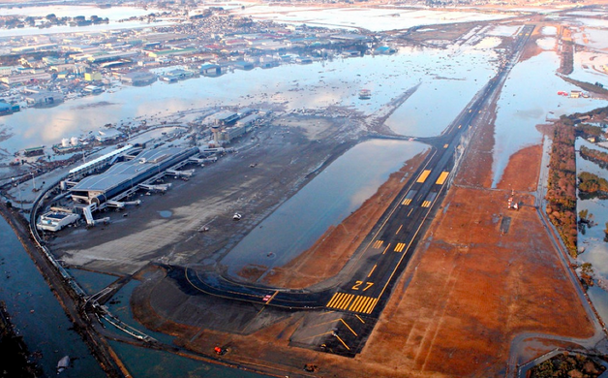
Notes:
Airports
The runways and facilities of airports along the coast may be damaged extensively or completely by
liquefaction-induced deformation and heaving, ground settlement, and tsunami impacts. The runways
of these airports are likely to be unusable by fixed-wing aircraft after the earthquake, although
helicopters may still be able to use some of the airfields to support relief efforts. Farther inland,
airports along the I-5 corridor (including Seattle/Tacoma International Airport and Portland
International Airport) are expected to experience only slight to moderate damage. These airports may,
however, experience fuel shortages due to disruption of the jet fuel that is delivered by pipeline.
http://crew.org/sites/default/files/cascadia_subduction_scenario_2013.pdf

Slide 30
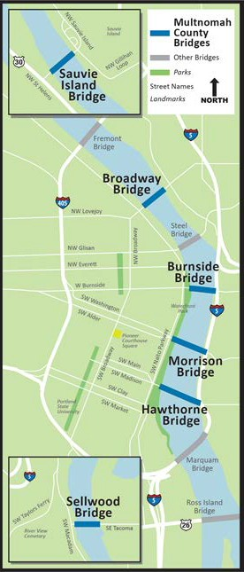



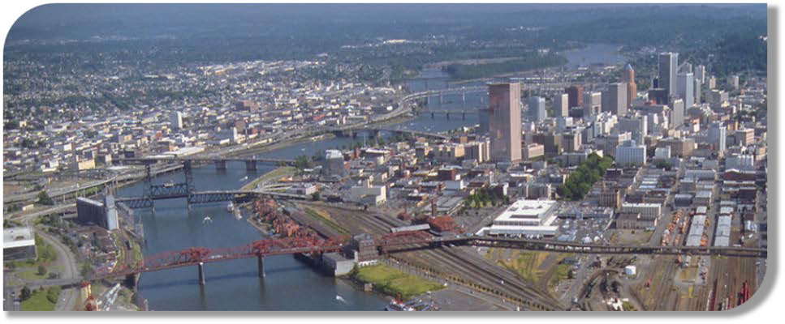

Willamette River Bridges
Sauvie Island Bridge 2008
Tilikum Crossing Bridge* 2015
Broadway Bridge 1913
Burnside Bridge 1910
Morrison Bridge 1958
Hawthorne Bridge 1910
Sellwood Bridge 2016
* Not a Multco bridge
Notes:
https://multco.us/earthquake-ready-burnside-bridge
Willamette Bridges, Capital Improvement Plan – Multnomah County - https://multco.us/bridgeplan
Bridge Damage Models for Seismic Risk Assessment of Oregon Highway Network, October 2011 - https://pdxscholar.library.pdx.edu/cgi/viewcontent.cgi?article=1021&context=trec_reports
Seismic Vulnerability of Oregon State Highway Bridges, Mitigation Strategies to reduce major mobility risks(ODOT Bridge Engineering Section Nov 2009) - http://www.oregon.gov/ODOT/Programs/ResearchDocuments/2009_Seismic_Vulnerability.pdf
Seismic Damage State Models for Oregon Bridges, Portland State University, Feb 2009 - http://trec.pdx.edu/research/project/148
Bridge Name, Vulnerability, Expected operability after the CSZ EQ
I-5 Interstate Bridge, Collapse, Closed
St. John’s Bridge, Extensive, Closed
I-405 Fremont Bridge, Moderate, Closed
I-5 Marquam Bridge, Moderate, Closed – Potential for Emergency Vehicles after 4 weeks (Allowing for inspection and some repair work)
US26 Ross Island Bridge, Collapse, Closed
I-5 Ramp Bridges (east side of Willamette River)*, Extensive, Closed
I-5 Boone Bridge, Slight to Moderate, Closed – Potential for Emergency Vehicles and limited and monitored public travel after 72 hours (Allowing for inspection. Any minor repair work will be performed under traffic)
I-84 Ramp Bridges (east side of Willamette River)**, Extensive, Closed
I-205 Glen Jackson Bridge, Slight to Moderate, Closed – Potential for Emergency Vehicles and limited and monitored public travel after 72 hours (Allowing for inspection. Any minor repair work will be performed under traffic)
I-205 Abernethy Bridge, Moderate, Closed – Potential for Emergency Vehicles and limited and monitored public travel after 72 hours (Allowing for inspection. Any minor repair work will be performed under traffic)
US30 Longview-Rainier Bridge (Lewis & Clark), WSDOT Bridge, HDR needs to check with WSDOT
Astoria - Megler Bridge, Collapse, Closed
Seismic vulnerability assessments for bridges are either based on the results of a computer model run (REDARS2) or an engineering algorithm. Conclusions have not been checked against any structural analysis to date.
Burnside bridge as LIFELINE
Centrally located, no overhead hazards, style of ridge that is easier to upgrade, ODOT focus on 205.
STEPS: feasibility study, NEPA study, secure design/row funding, secure construction funding, construction (2024) with an estimate of 4 years to complete (2028)
ALTERNATIVES for bridge work include (all on the table): preserve, retrofit, replace (low moveable, high fixed, tunnel) hybrid, enhance
Considerations – lateral spread and liquifaction

Slide 31
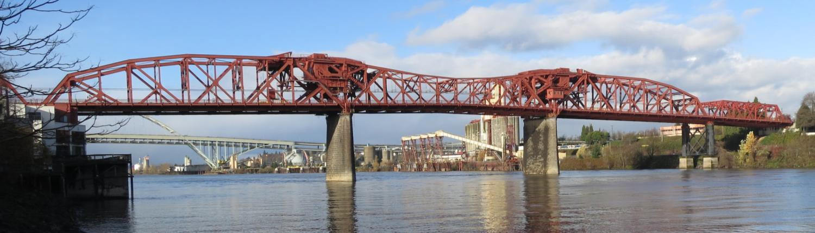
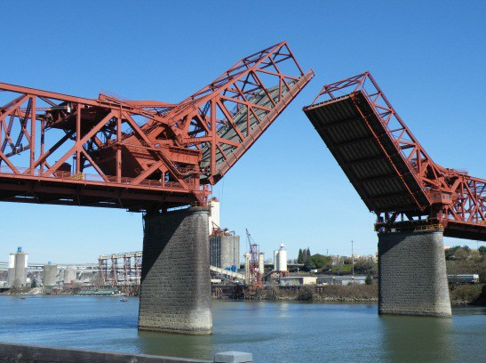
Primary Seismic Vulnerabilities:
Bridge falling from its supports
Piers and columns
Below-water foundations
Rall wheel and track
Mechanical and electrical components
Soil liquefaction settlement
Truss members
Bearing elements
Notes:
Burnside bridge video
https://drive.google.com/file/d/0B7tgJBkLLflydDB6WVVCcE8xdVU/view?ts=58e2ba1f
When the Hawthorne bridge was built there were more horse drawn carriages than cars. 1910

Slide 32
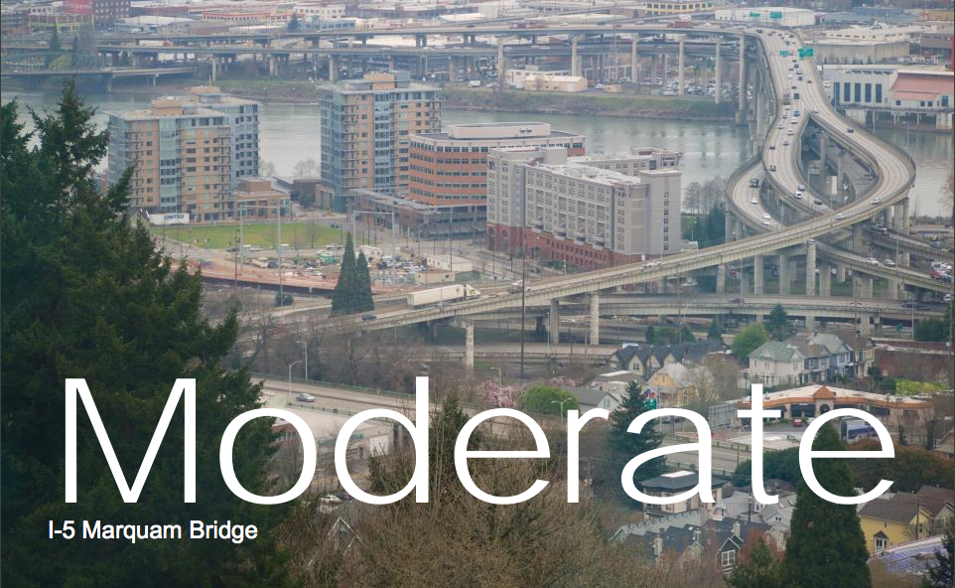
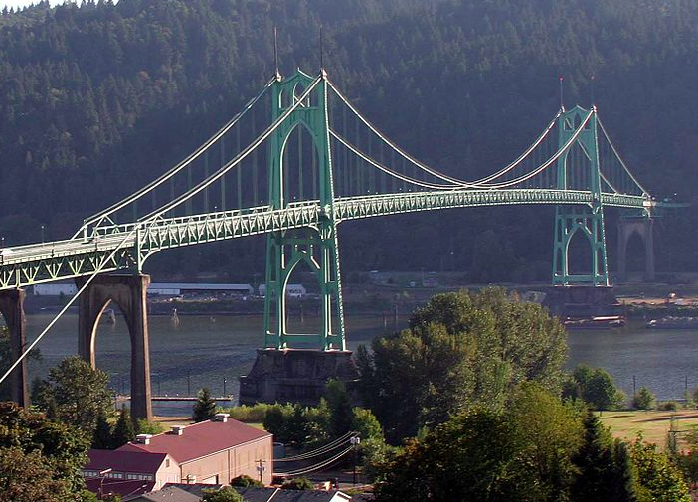
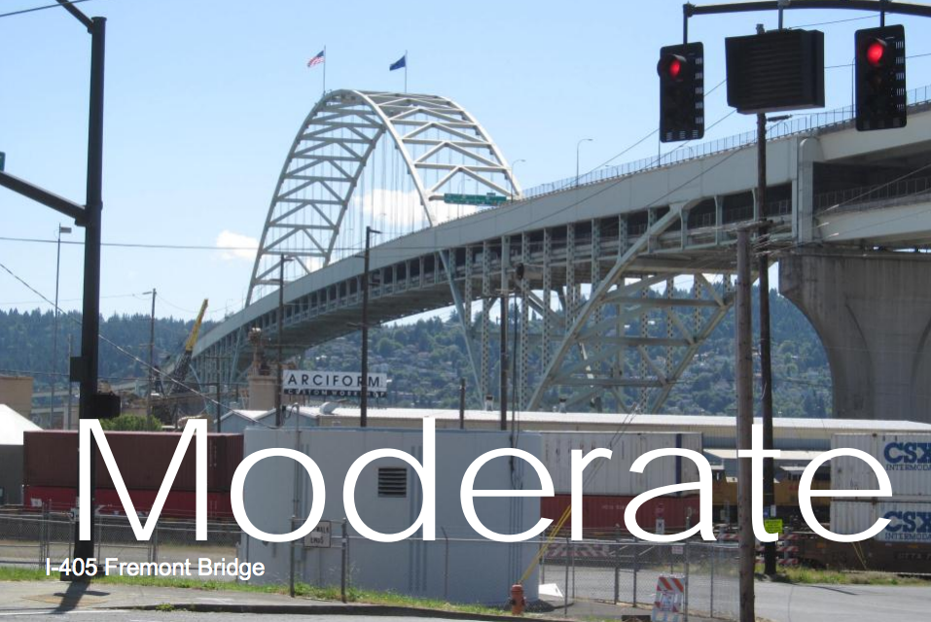

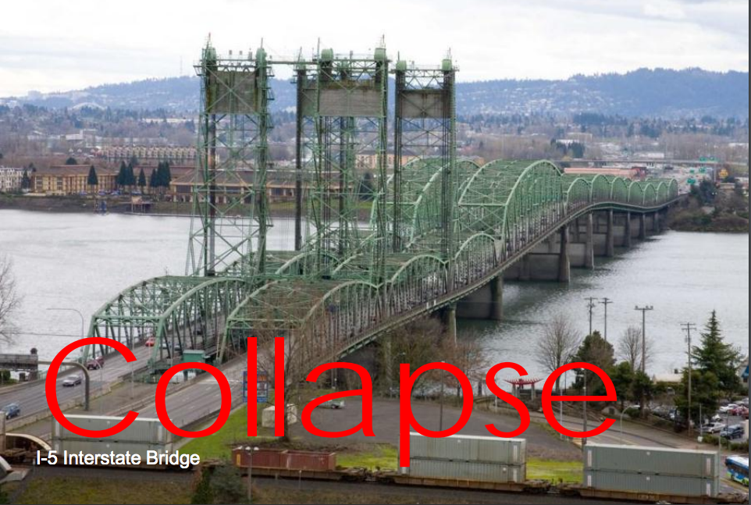
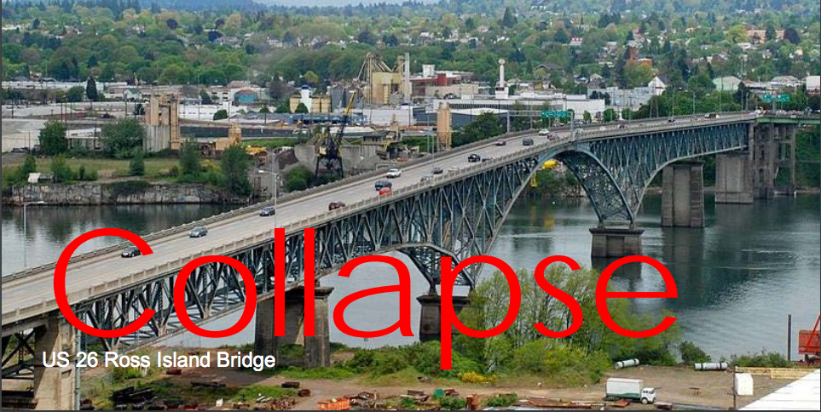
St John’s Bridge
1929
Extensive
Notes:
Bridge Name, Vulnerability, Expected operability after the CSZ EQ
I-5 Interstate Bridge, Collapse, Closed
St. John’s Bridge, Extensive, Closed
I-405 Fremont Bridge, Moderate, Closed
I-5 Marquam Bridge, Moderate, Closed – Potential for Emergency Vehicles after 4 weeks (Allowing for inspection and some repair work)
US26 Ross Island Bridge, Collapse, Closed
I-5 Ramp Bridges (east side of Willamette River)*, Extensive, Closed
I-5 Boone Bridge, Slight to Moderate, Closed – Potential for Emergency Vehicles and limited and monitored public travel after 72 hours (Allowing for inspection. Any minor repair work will be performed under traffic)
I-84 Ramp Bridges (east side of Willamette River)**, Extensive, Closed
I-205 Glen Jackson Bridge, Slight to Moderate, Closed – Potential for Emergency Vehicles and limited and monitored public travel after 72 hours (Allowing for inspection. Any minor repair work will be performed under traffic)
I-205 Abernethy Bridge, Moderate, Closed – Potential for Emergency Vehicles and limited and monitored public travel after 72 hours (Allowing for inspection. Any minor repair work will be performed under traffic)
US30 Longview-Rainier Bridge (Lewis & Clark), WSDOT Bridge, HDR needs to check with WSDOT
Astoria - Megler Bridge, Collapse, Closed
Seismic vulnerability assessments for bridges are either based on the results of a computer model run (REDARS2) or an engineering algorithm. Conclusions have not been check against any structural analysis to date.
Burnside bridge as LIFELINE
Centrally located, no overhead hazards, style of ridge that is easier to upgrade, ODOT focus on 205.
STEPS: feasibility study, NEPA study, secure design/row funding, secure construction funding, construction (2024) with an estimate of 4 years to complete (2028)
ALTERNATIVES for bridge work include (all on the table): preserve, retrofit, replace (low moveable, high fixed, tunnel) hybrid, enhance
Considerations – lateral spread and liquifaction

Slide 33
Current Resilience Gap
Critical Service | Zone | Estimated Time to Restore
Electricity | Valley | 1 to 3 months
Electricity | Coast | 3 to 6 months
Police and Fire Stations | Valley | 2 to 4 months
Drinking Water and Sewer | Valley | 1 month to 1 year
Drinking Water and Sewer | Coast | 1 to 3 years
Top-priority highways (partial restoration) | Valley | 6 to 12 months
Healthcare facilities | Valley | 18 months
Healthcare facilities | Coast | 3 years
Notes:
http://www.oregon.gov/oem/Documents/Oregon_Resilience_Plan_Final.pdf

Slide 34
Infrastructure Grades
ASCE 2017
Awareness Resources
Aviation D
Bridges C+
Roads D
Dams & levees D
Drinking Water D
Energy D+
Hazardous Waste D+
Rail B
Schools D+
Solid Waste B-
Transit D-
Wastewater D+
http://www.asce.org/reportcard/
Notes:
Link to website to find out specific information

Slide 35
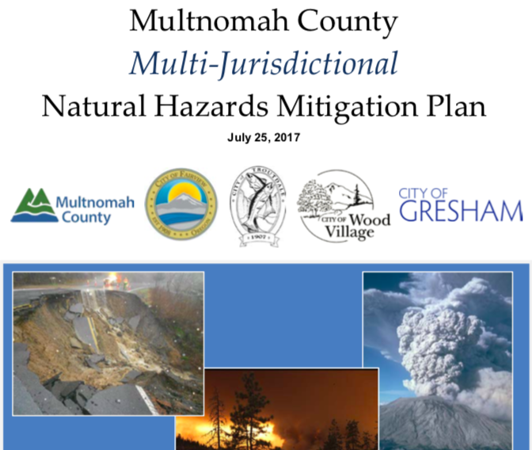
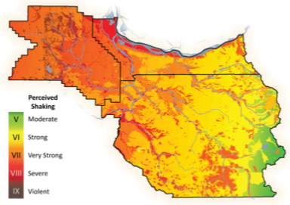
Awareness Resources
DOGAMI
Notes:
https://multco.us/em/natural-hazard-mitigation-plan-document-library
State of Oregon, Oregon Department of Geology and Mineral Industries. Brad Avy, State Geologist
OPEN-FILE REPORT O-18-02, EARTHQUAKE REGIONAL IMPACT ANALYSIS FOR CLACKAMAS, MULTNOMAH, AND WASHINGTON COUNTIES, OREGON by John M. Bauer1, William J. Burns1, and Ian P. Madin. 2018, Oregon Department of Geology and Mineral Industries, 800 NE Oregon Street, Suite 965, Portland, OR 97232
https://multco.us/em/emergency-preparedness

Slide 36

Awareness Resources
Emergency Operations
and Response Plans
Hot washes and
After Actions
Training and Exercises
https://multco.us/em/emergency-management-training
https://multco.us/em/emergency-preparedness
Notes:
Sources: Tribal/Federal/State/County/City Emergency Management Offices, Fire Departments, School Districts, Utilities

Slide 37
Emergency Alerts and Warnings https://www.facebook.com/MultcoEM/
Awareness Resources
IS-248 IPAWS for the American People
  Wireless Emergency Alerts
  Emergency Alert System
  CENS: www.publicalerts.org
  Everbridge, Code Red, First Call…
  FEMA App: https://www.fema.gov/mobile-app
Amateur Radio Communications
http://www.arrl.org/getting-licensed
https://www.multnomahares.org/
Notes:
https://training.fema.gov/is/courseoverview.aspx?code=IS-248

Slide 38
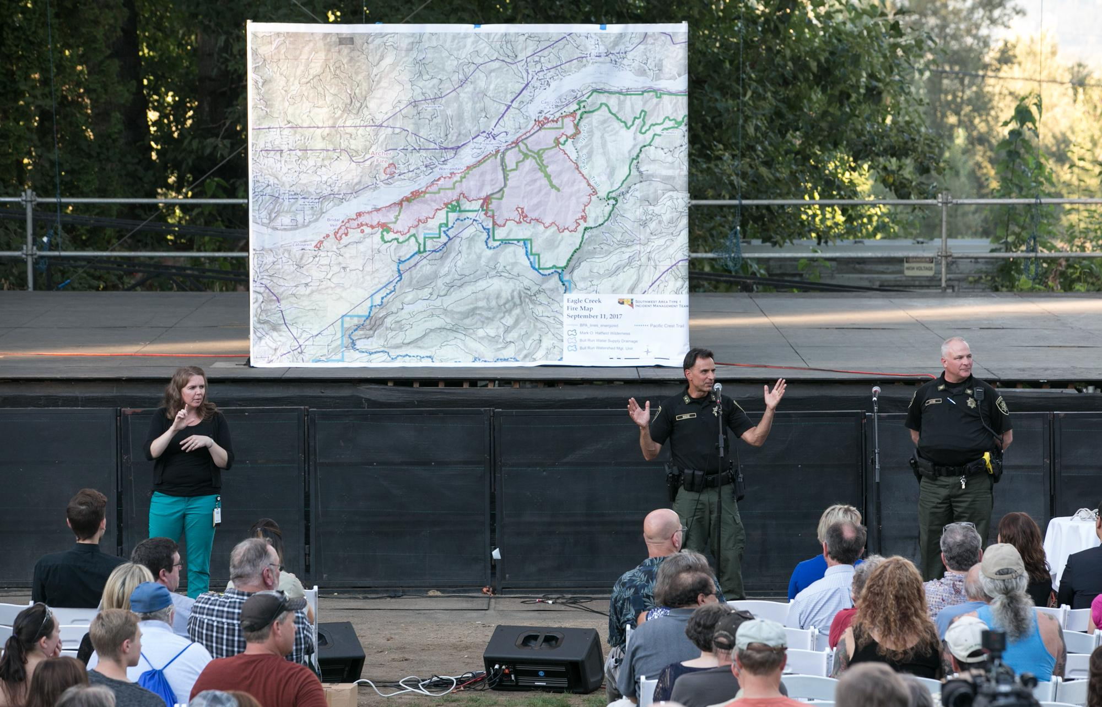
Awareness Resources
How / Where are you going to get your information?
TRAPLINE

Slide 39
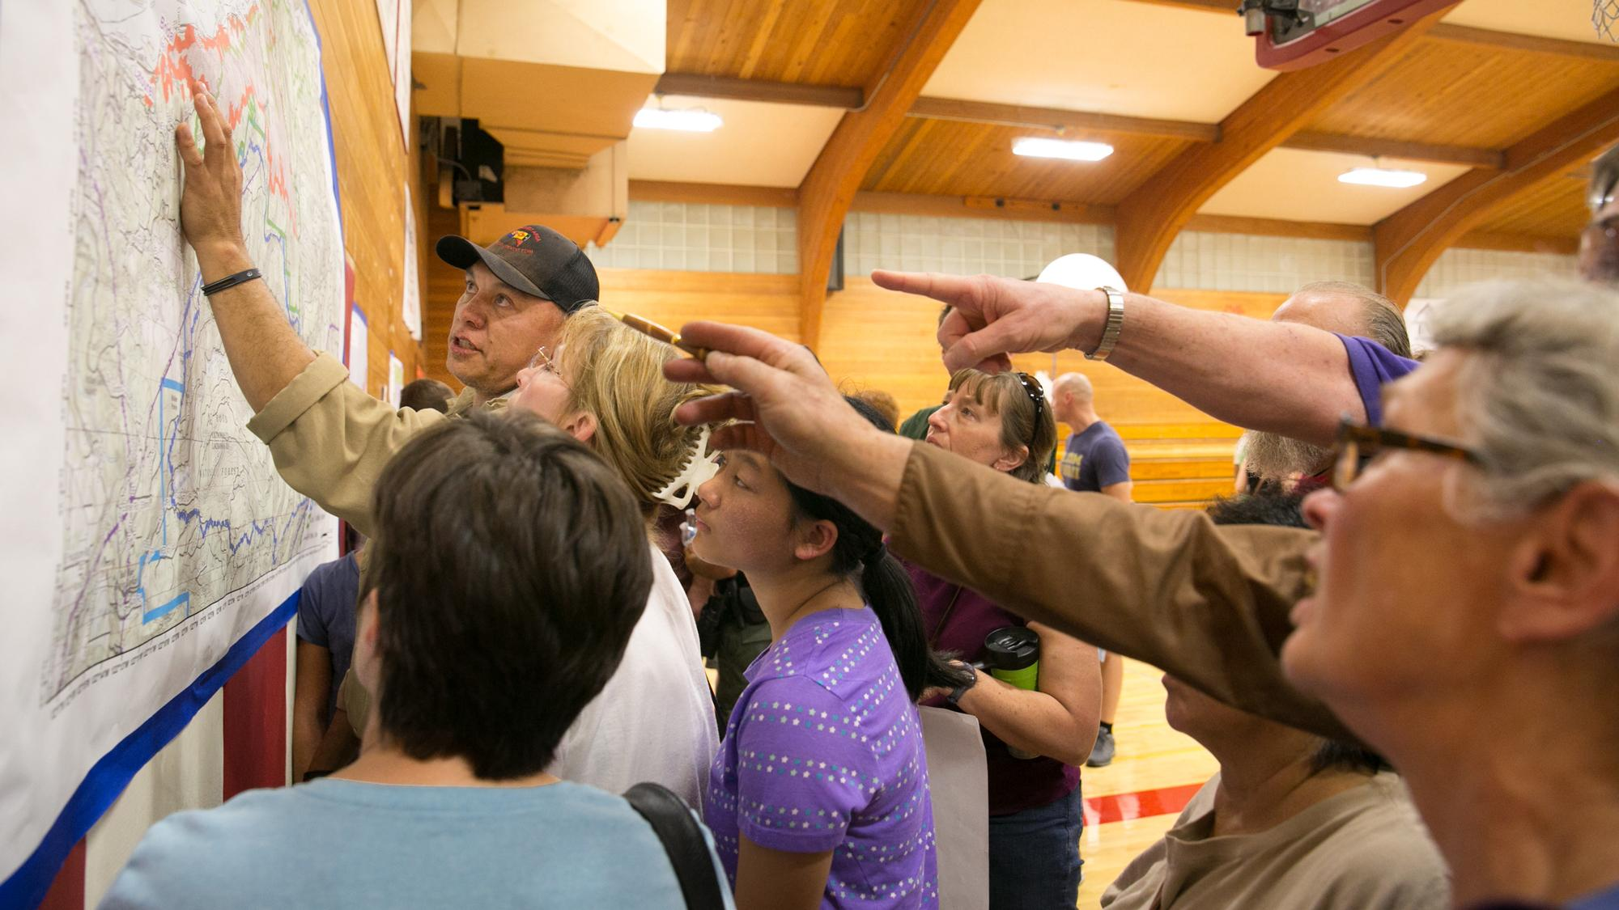
Awareness Resources
Community Meetings

Slide 40
Resiliency Factors
Access to Information and Education
Physical Health
Psychological Hardiness
Community Connectedness

Slide 41
Priority - Make a Plan
Car Kits: Where are you going? How are you going to get there? What are you going to want to do there?
For how long?
Home 'kits’: Why make a 'bug out bag' or 'go kit’ - where are you going/Why are you going? How long will you be there? How are you going to get there?
Office kit: What role do you want to play after a disaster?
What items might you need in order to fulfill that role? What items do you need to protect your head, feet, hands, eyes, and nose? How long do you think you will need supplies to last?
Notes:
Prior to building any kit - determine its objectives:
Car Kits:
Where are you going?
How are you going to get there?
What are you going to want to do there?
For how long?
Home 'kits' - why make a 'bug out bag' or 'go kit':
Where are you going?
Why are you going?
How long will you be there?
How are you going to get there?
Office kit
What role do you want to play after a disaster?
What items might you need in order to play that role?
What items do you need to protect your head, feet, hands, eyes and nose?
How long do you think you will need supplies to last?
----- Meeting Notes (2/4/17 13:13) -----
Panic
ts

Slide 42

Medications
Notes:
Multnomah County Health recommends that individuals meet with their doctor to discuss their medications. Ask - “ If I run short on medications, which (if any) would put my life at risk? Could I take a half a pill a day – a fourth a pill? Doctors can prescribe an additional 30 – 60 – 90 but insurance won’t pay. Narrowing down the meds you MUST have, may make having emergency supply more affordable.
Do NOT keep extra meds in a car – heat degrades medications

Slide 43
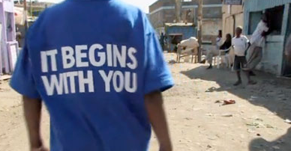
Role as an Individual
Notes:
Identify how you would like to be involved in the solution – response and recovery effort
Determine the gap between where you are and where you need to be – close the gap.
Personally prepare
Ensure family and loved ones are prepared
Balance between personal – community - and government responsibility
Civically active – involved – aware

Slide 44
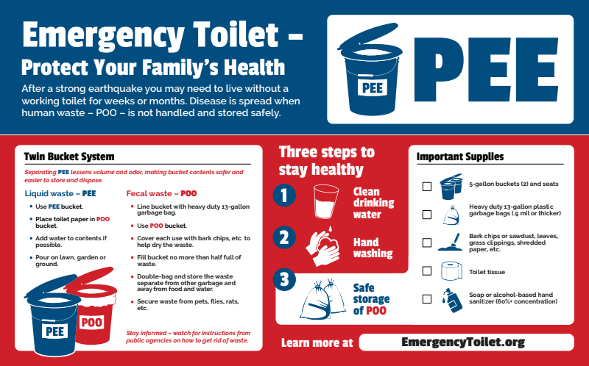
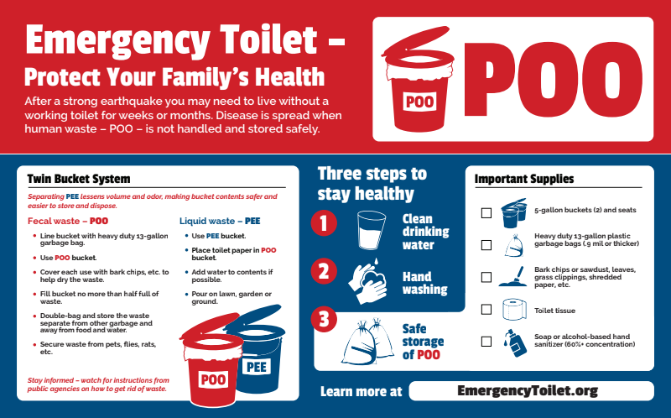
Disaster Sanitation
Twin Bucket System
Latrine (Pit Toilet)
Septic System

Slide 45
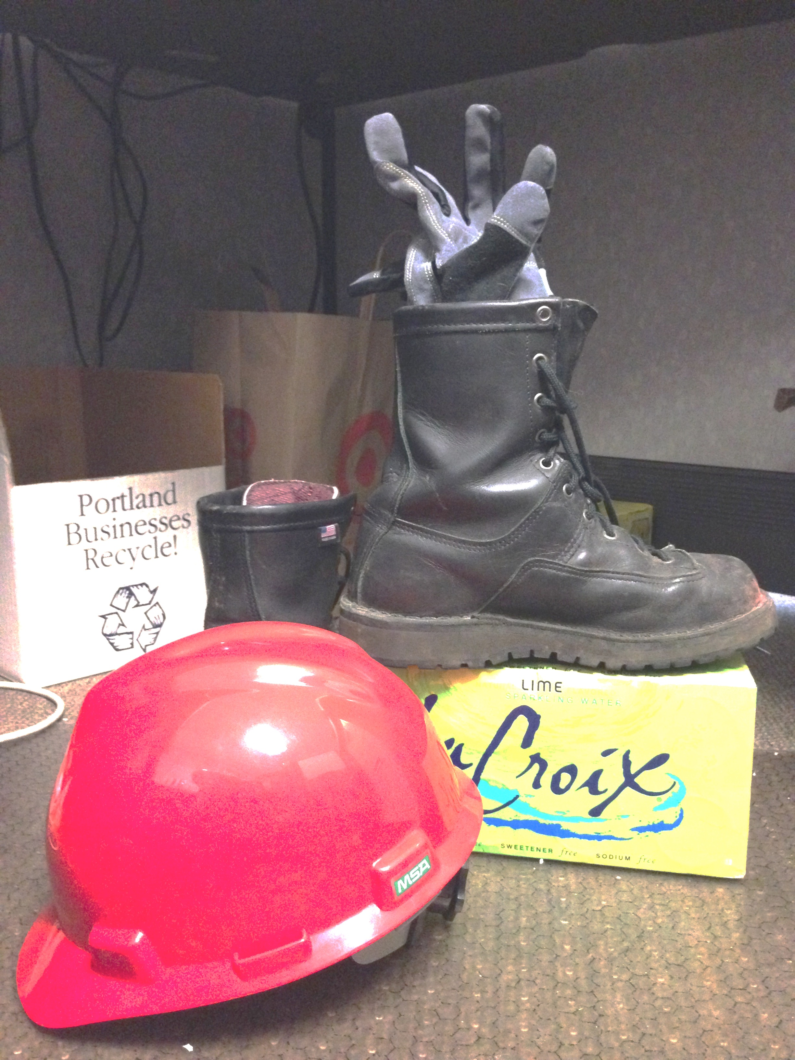

Slide 46
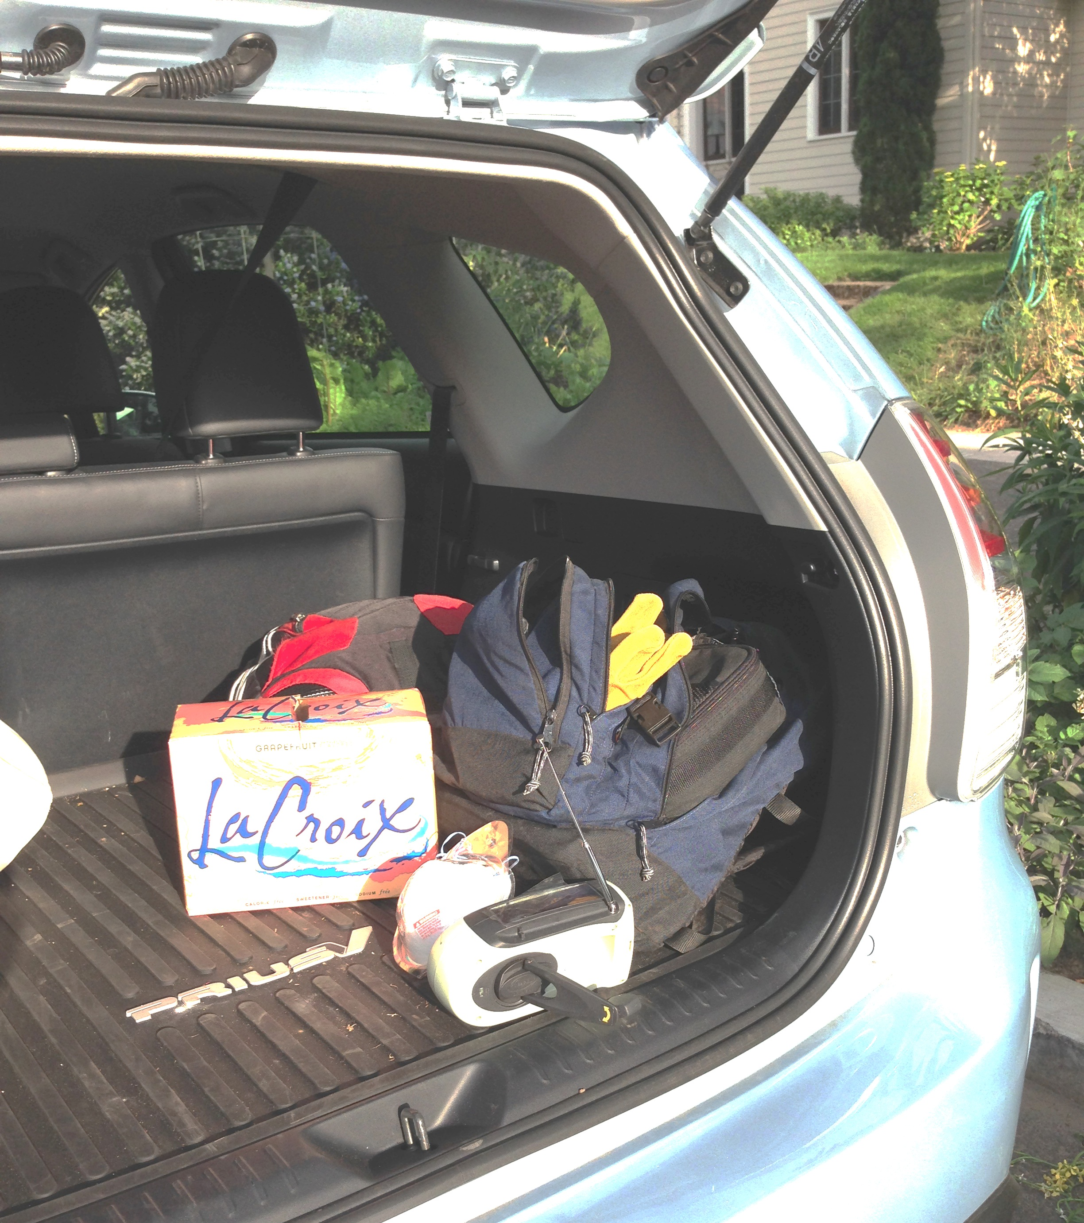

Slide 47
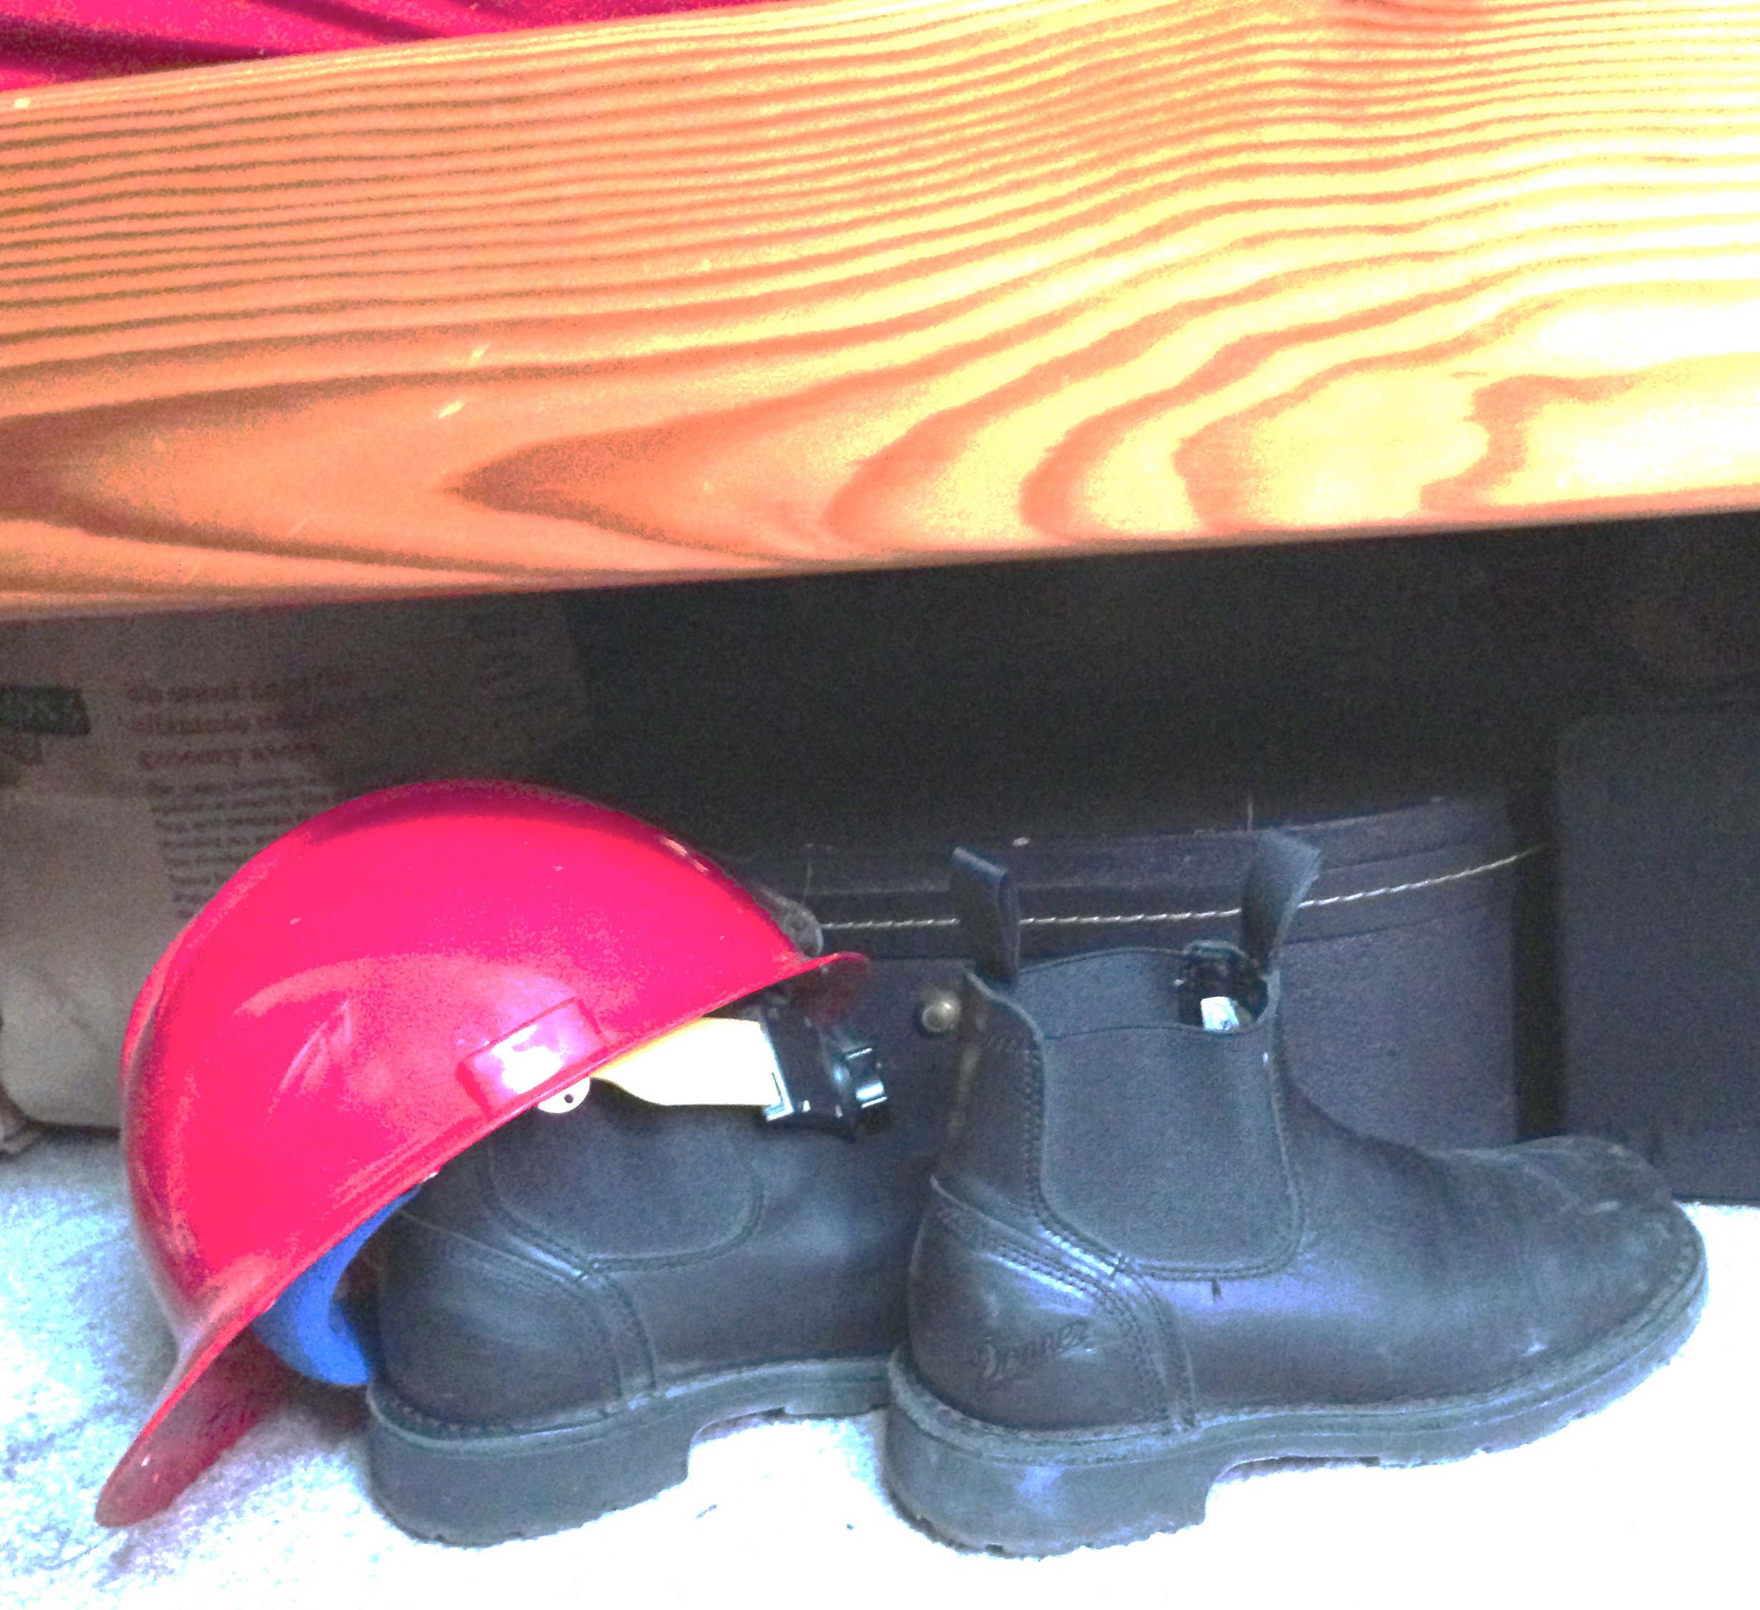

Slide 48
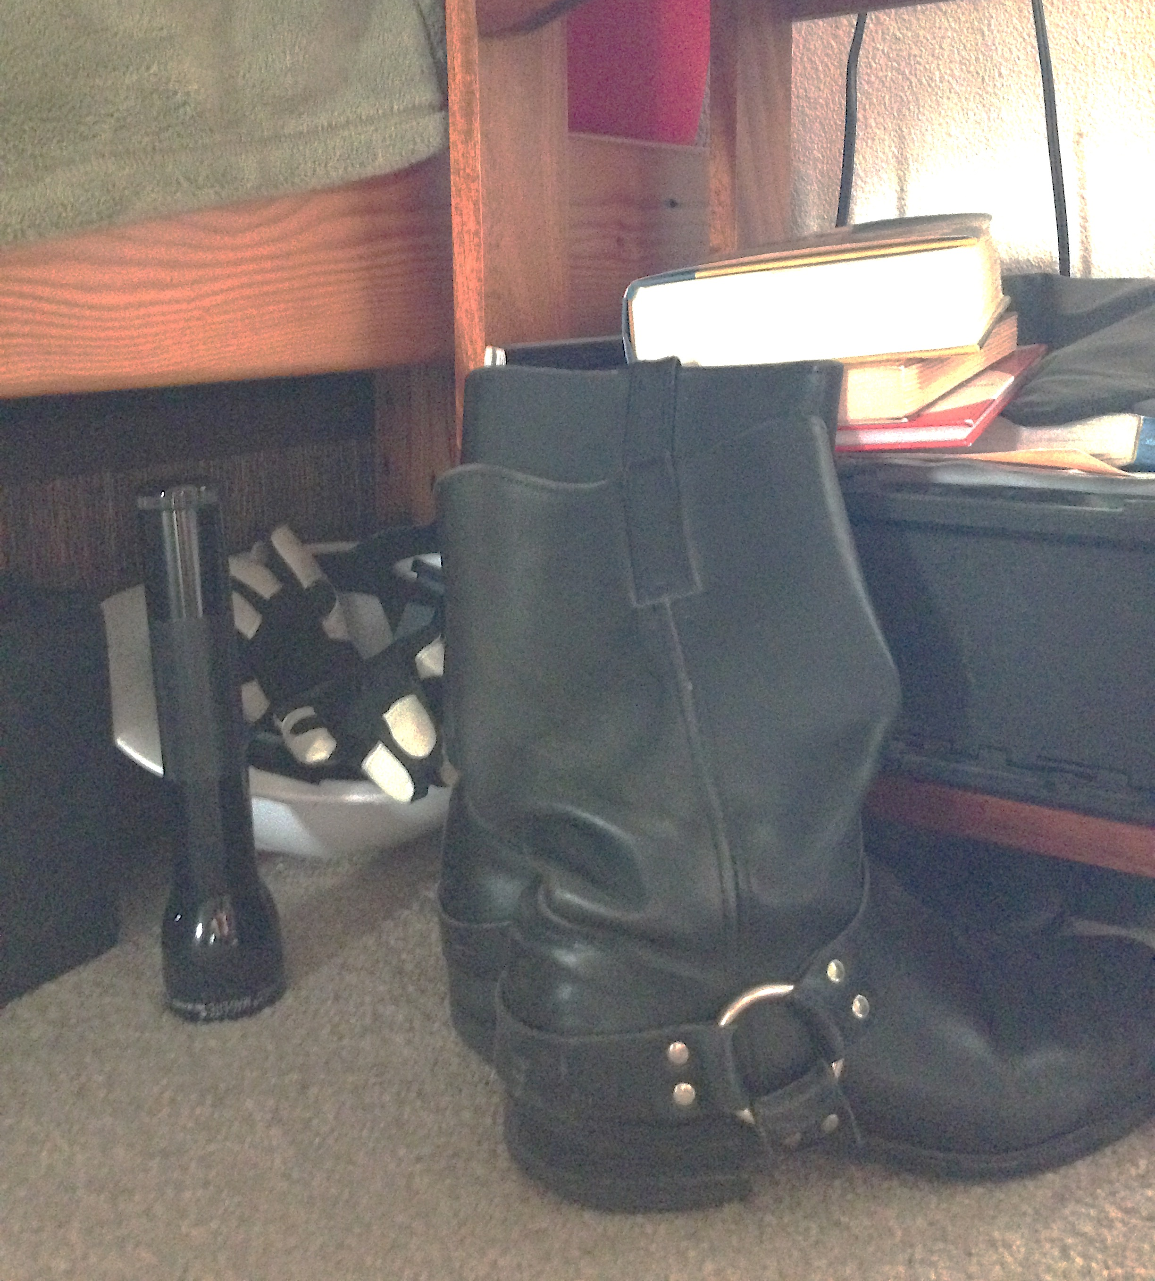

Slide 49
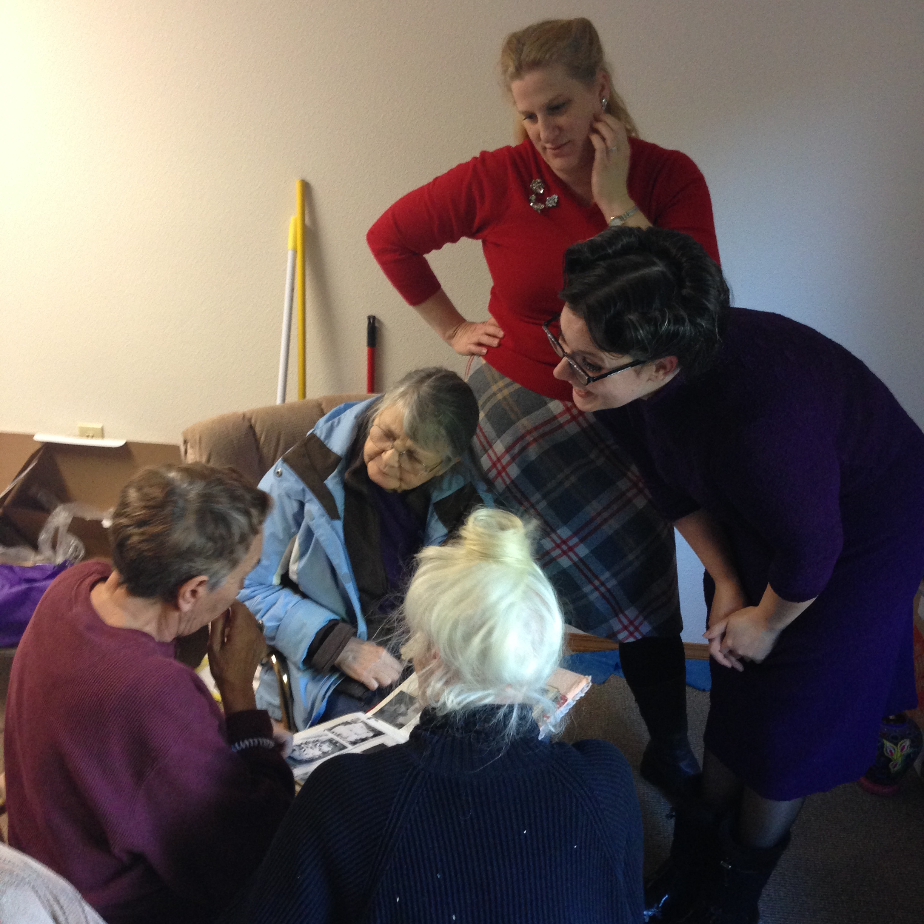
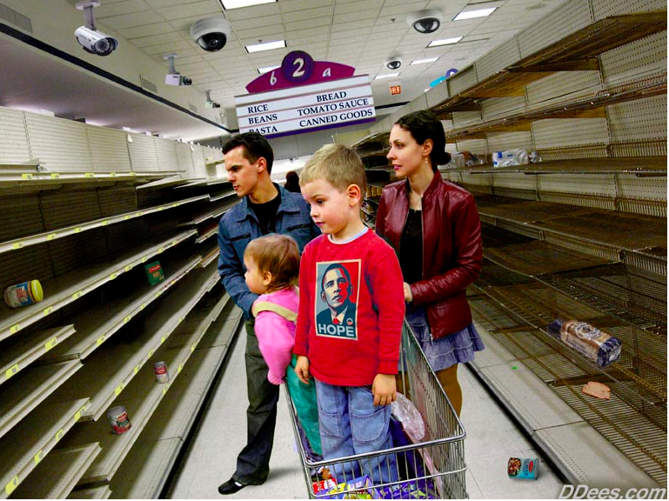

Slide 50


Slide 51

Notes:
We live on the ring of fire… and actually it may be as bad as it sounds… this is where most of the earthquakes and volcanoes occur in the world… it’s the edge of the Pacific plate where it comes in contact with the North and South American Plates, the Asian Plate and the Australian Plate…
The reason this region is full of earthquakes and volcanoes is that all these plates are still moving… North and South America at about an inch a year to the west, Asia to the east, Australia who knows where and the pacific plate several directions at once because it is still growing!

Slide 52


Slide 53



Slide 54


Slide 55




Slide 56


Slide 57


Slide 58


Slide 59

Role as a Neighbor
Notes:
Do you know your neighbors? If so, how did you meet them and get to know them? If not, why not?
What are some concerns? benefits?
What are some things you would like to know about your neighbors?
What are some ways to get to know your neighbors?
What could you use help with? Is there anything that would make getting to know your neighbors easier?

Slide 60

Community Connections
Social Capital
Know Your Neighbor
Block Parties
Community Gardens
Apartment Groups
Political Activities
Neighborhood Assoc.
Religious Communities
Outdoor Activities
Progressive Dinners
Multnomah County Sheriff’s Office Citizen Patrol, Search and Rescue
Neighborhood Emergency Teams
Red Cross
Ham Radio - ARES
Medical Reserve Corps
Trauma Intervention Program

Slide 61


Slide 63

Spontaneous Volunteers

Slide 64

Organized Volunteers

Slide 65










































Notes:
Anecdotally

Slide 66

Attempting to be the person my dog thinks I am…

Slide 67


